Slide 1
Energy Use in <community>
Presentation to Maintenance and Operations Staff
<Insert community photo or logo>
A joint initiative brought to you by:
Ministry of Energy and Mines
BC Hydro
Developed and delivered by:
Quality Program Services
Notes:
Introduction of presenters.
Welcome the community and elders.
Thank you for the welcome into their space.
Explain why you’re here.

Slide 2
Introduction and Outline
Why energy use should matter to you!
Energy use and home structure
Understanding energy bills
Benefits of energy efficiency
Common energy related housing issues in <insert community>
Policy and procedure information
Notes:
Go over the outline of what will be covered in this presentation.

Slide 3
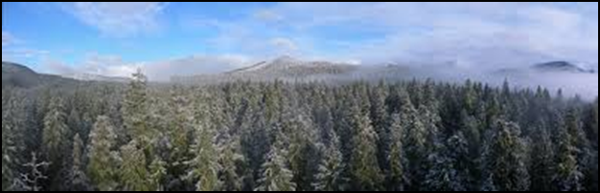
Why it Matters
Energy use impacts Maintenance and Operations staff:
  Workload
    Defined procedures (resident requests, etc.)
    Quality of materials reduces need for continual replacement
  Protect housing lifespan
  Help residents improve homes
  Protect the land
Energy use is on the rise in BC, and our intent is to decrease consumption to take pressure off the system as a whole
Notes:
Incorporating energy efficiency practices and a larger program impacts maintenance staff by:
-better defining guidelines and procedures for purchasing and dealing with resident’s requests
-reducing workload through longer rotation times of various appliances or materials
-helping community members maintain healthier and safer homes, as well as reduce energy bills
-your land (how power generation and use can impact the environment)

Slide 4
General Energy Information
The energy supply in <insert community> comes from:
Natural gas
Typically found above petroleum resources
Propane
Byproduct of natural gas processing and petroleum refining
Electricity
Hydroelectricity and/or diesel generation in remote communities
Wood
Locally sourced and used
Notes:
Give context about the impacts of the energy use applicable to this community (e.g. electricity and natural gas primarily).

Slide 5
<Insert community> -specific Energy Information
Housing types and age
# Homes: rental vs owned
Estimated cost of electricity/fuel paid for by the nation
Current programs or initiatives regarding housing and organizational structure
Short and long term outlook for housing: new construction and upgrades
Notes:
Explain (based on previous investigation/data gathering) or ask the community about their current energy efficiency situation, including:
Most common types and ages of housing in the community
How much the community is paying for electricity (all types) as a whole or as individual homeowners
Existing programs and initiatives shaping community housing and home energy usage/ energy efficiency
Challenges being faced by different groups in the community (budgetary, maintenance, living situation, etc.)

Slide 6
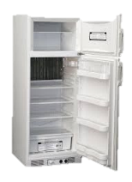

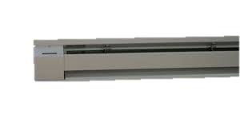


Where are your energy dollars going?
A Breakdown of Average Canadian Home Energy Use
When Total Energy Bill is $2,000 a year
Notes:
The average Canadian spends about $2000 per year on electricity.
*this data is from a few years ago, so the number may be a bit higher now.
When we look at where this energy is being used, we can see that 60 percent of it ($1,200) is going to Space Heating.
Another 20 percent is going to Water Heating.
Appliances (refrigerators, televisions), lighting and cooling make up the rest, but they are a much smaller portion.

Slide 7
First Nation Energy Use and Cost can be Double*
When Total Energy Bill is $4,000 a year
*No statistical data available – based on anecdotal experience
Notes:
Anecdotal evidence suggests that energy costs for First Nations communities can be double, or more, the costs for the average Canadian household.
This means many First Nations households can easily be spending $4,000/year on energy (primarily a combination of electricity and gas costs).
In these cases, that means that 80%, or $3,120 of those energy dollars, are going to space and water heating alone!
So if you want to lower your bills, where should you focus your efforts?
Changing lightbulbs isn’t a bad idea, but prioritizing improvement to heating and keeping heat in (i.e., draftproofing) is where you can make the biggest impact.

Slide 8
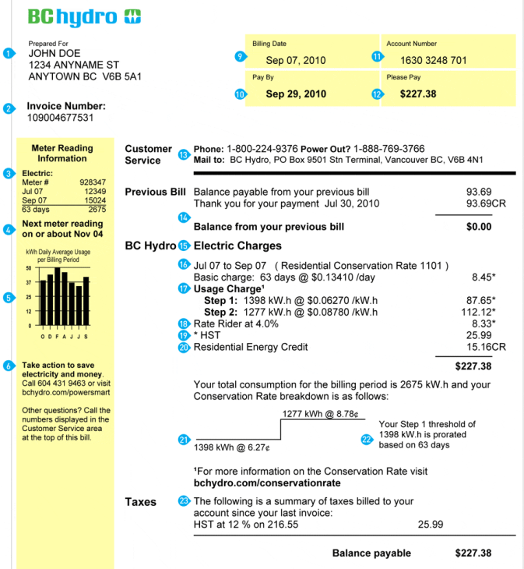
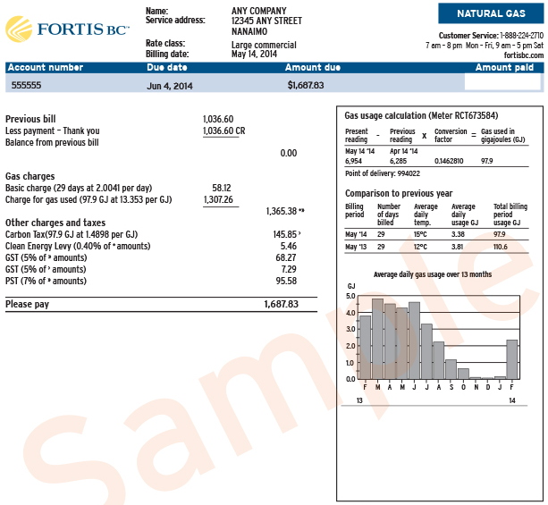
Understanding Your Energy Bill
Notes:
There is a lot of information on your energy bills, but if you’re only going to take note of a couple different parts, take note of these ones:
Hydro:
Your Hydro rates are stepped. That means that usage up to a certain amount is charged at $0.XX [use rates for this community], and anything you use beyond that number of kWhs is charged at a higher rate. If possible, it’s best to try to stay below the threshold where you jump up to the higher rate. You might not notice this in your bills (if you have equal payment billing, for example), but you will be paying for it in the end.
Fortis:
On the side of your Hydro bill and also on your Fortis bill, there is a little bar chart that shows your usage over the year. Take a look at this and see where there are fluctuations. If you live in a place where you don’t use space heating in summer months, the levels you’re using in summer months are mostly how much you’re using to heat water and power appliances.

Slide 9

Notes:
[Only for communities with Smart Meters]
BC Hydro has a great program called My Hydro.
Ask if anyone present is signed up.

Slide 10
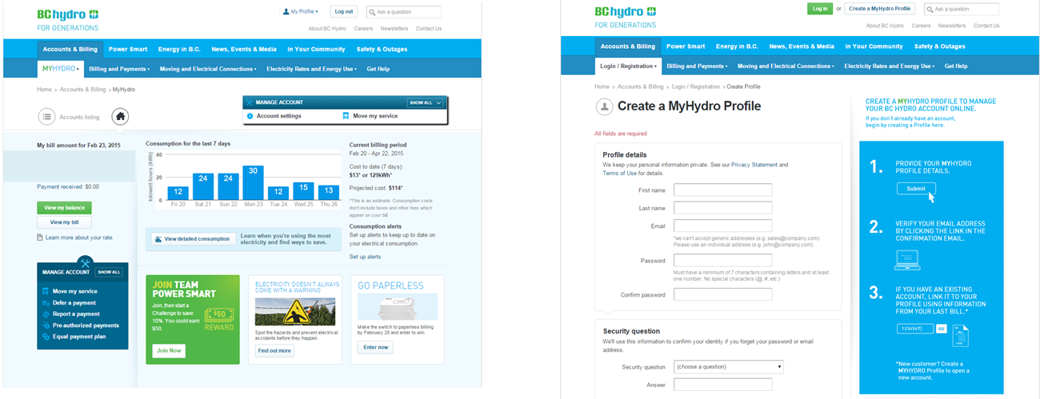
Using My Hydro
Notes:
With My Hydro, you can log on and see your energy usage in real time. This is really helpful if you’re not sure where you’re using electricity.
If your home is empty all day and you have spikes in your usage during that time, maybe you have baseboard heaters on (and set too high). This can help you figure out where you’re using your energy.
All you have to do is create a profile (it’s free).
It’s also a great place to find tips and to learn about rebates and other programs that might be available to you.

Slide 11
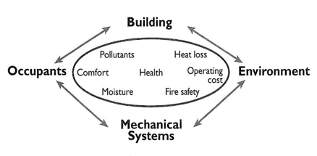
Factors Affecting Energy Efficiency
Construction
  Building code standards
  Installation and inspection procedures
Maintenance
  Materials procurement
  Procedures
Energy awareness
  Knowledge
  Behaviours
Notes:
There are 3 main contributors to energy consumption:
Construction
-to what level of building code standard we decide to build to which essentially describes how well our homes are designed, built and what materials are used
-level of professionalism in installation and inspection procedures
Maintenance
-how we keep our homes in good shape (or not)
-what materials and methods we’re using for maintenance
and Behaviour
-what we know about how to reduce our consumption
-if we actually do it

Slide 12
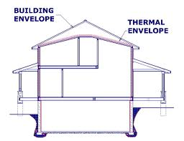
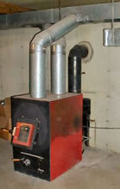
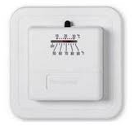
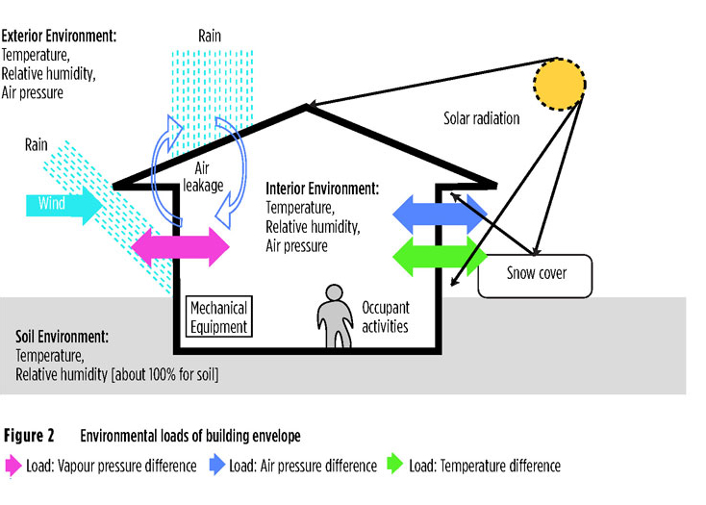
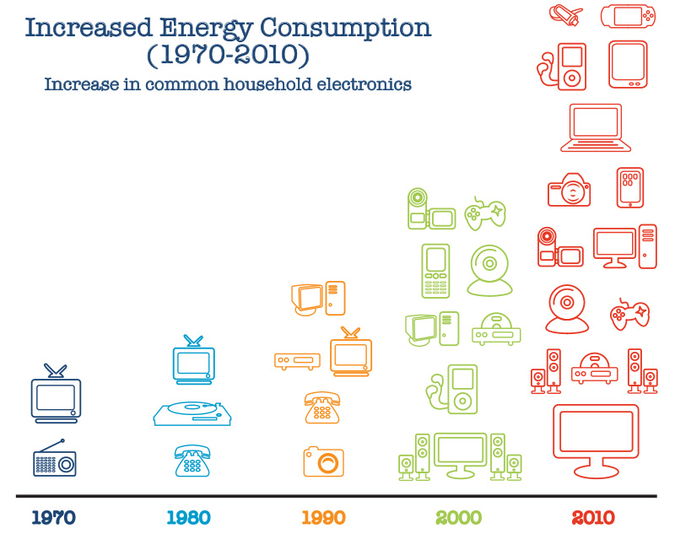
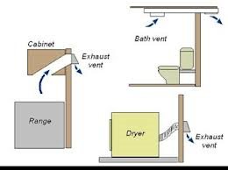
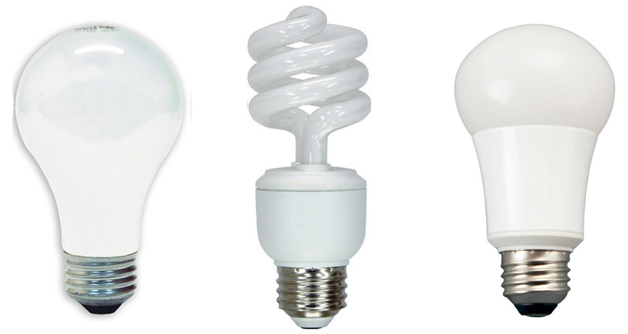
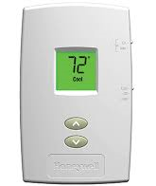
Home Structure and Components
Building envelope
  Moisture and ventilation
Heating systems
  Controls
Lighting
Appliances and
plug loads
Notes:
Our Home Structure and Components help determine out energy usage:
The Building Envelope is our walls, floors and roofs – everything that keeps weather out and keeps warmth in. We also want to consider the movement of moisture in our homes, particularly when we start to improve how airtight they are. When homes are sealed really well, a good ventilation system needs to be in place to move air, and remove excess moisture from showering, cooking, etc.
How we use heating system controls (thermostats) also makes a big impact: using old analog thermostats or dials on baseboard heaters can be very inefficient, and installing programmable thermostats that regulate temperature better can have a big impact on bills.
The light bulbs we choose make a difference too, and can really add up depending on how many lights we have in our home. LED bulbs are the most efficient, compared to old incandescent ones, and provide a lot nicer light than CFL bulbs.
Finally, since the 1970s, the number of appliances we have in our homes has changed a lot. It isn’t uncommon for one household to have multiple TVs, computers and all sorts of gadgets plugged in and running which really increases the load on our homes.

Slide 13
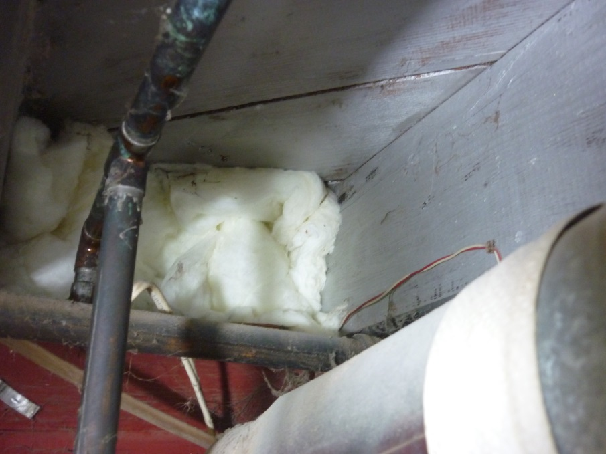
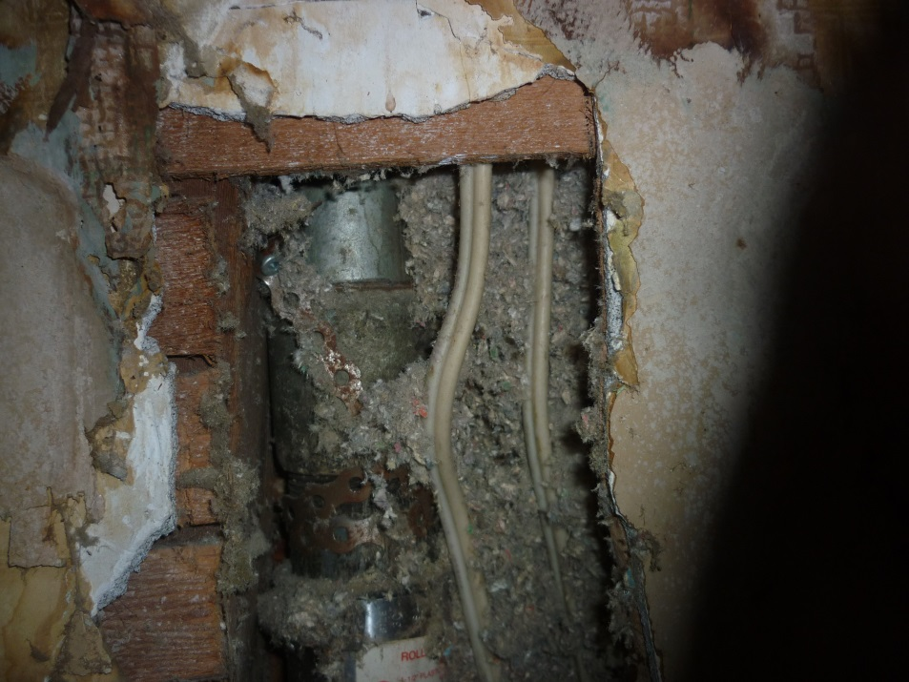
Envelope Air Sealing –
What does it cost?
Cost:
___/year
Cost:
___/year
Notes:
Assumptions: Electrical cost Zone 1 blended rate as of March 1, 2015.
Lower Mainland – Box joists: $28.00; hole in wall (110cm²): $36.00
South Interior – Box joists: $50.00; hole in wall (110cm²): $55.00
North Interior – Box joists: $74.00; hole in wall (110cm²): $105.00

Slide 14
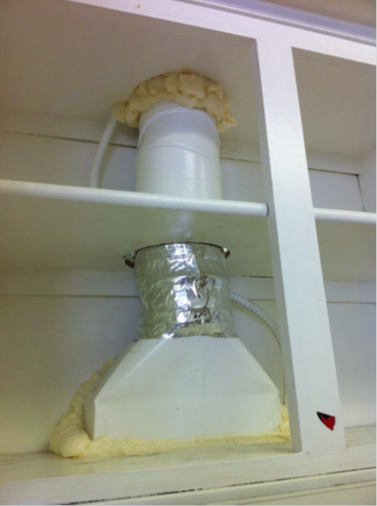
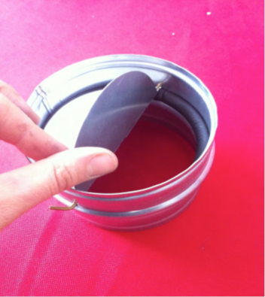
Fans, Vents, and Ducts
Cost:
___/year
Notes:
Assumptions: Electrical cost Zone 1 blended rate as of March 1, 2015
Lower Mainland – $18.00
South Interior – $22.00
North Interior – $42.00

Slide 15
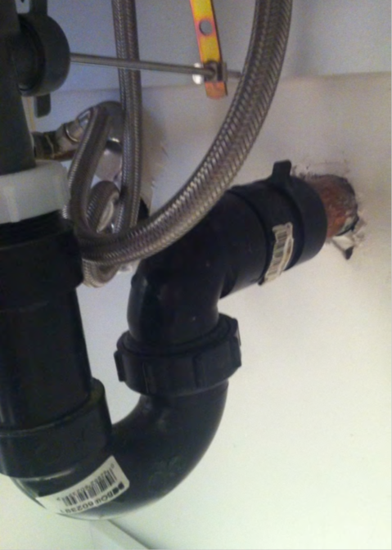
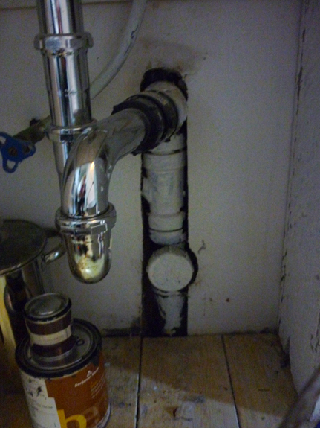
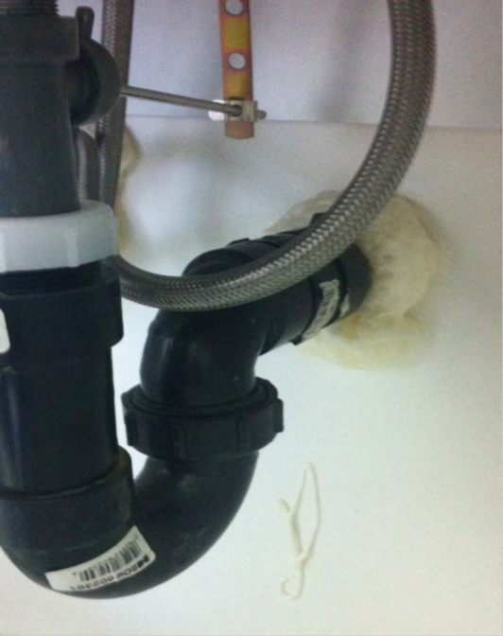
Plumbing and Penetrations
Cost:
___/year for 3 pipes
Notes:
Assumptions: Electrical cost Zone 1 blended rate as of March 1, 2015. Homes have 3 plumbing penetrations.
Lower Mainland – $54.00
South Interior – $66.00
North Interior – $125.00

Slide 16

Exterior Doors
Cost:
__/door/year
Notes:
Assumptions: Electrical cost Zone 1 blended rate as of March 1, 2015. Value per door.
Lower Mainland – $5.00
South Interior – $7.00
North Interior – $13.00

Slide 17
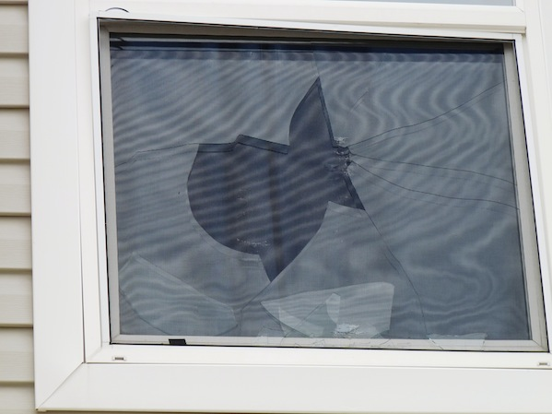
Windows
Cost:
___/window/
year
Cost:
__/window/year
Notes:
Assumptions: Electrical cost Zone 1 blended rate as of March 1, 2015. Value per window.
Broken window/single pane:
Lower Mainland – $23.00
South Interior – $42.00
North Interior – $63.00
Window gap:
Lower Mainland – $4.00
South Interior – $5.00
North Interior – $10.00

Slide 18
Building Envelope and Draftproofing – What can be done!
Building:
Ensure adequate insulation in walls, attics, and crawl spaces
Draftproofing - seal holes and gaps to exterior, especially around pipes and other wall penetrations
Install doors and windows correctly with no gaps or misalignment
Install air and moisture barriers in crawlspaces
Conduct blower door tests on new homes
Behaviour:
Remind residents to keep doors and windows fully closed when trying to maintain inside temperature
Notes:
Discuss list of building fixes and resident behaviours, and any other suggestions the audience brings up.

Slide 19
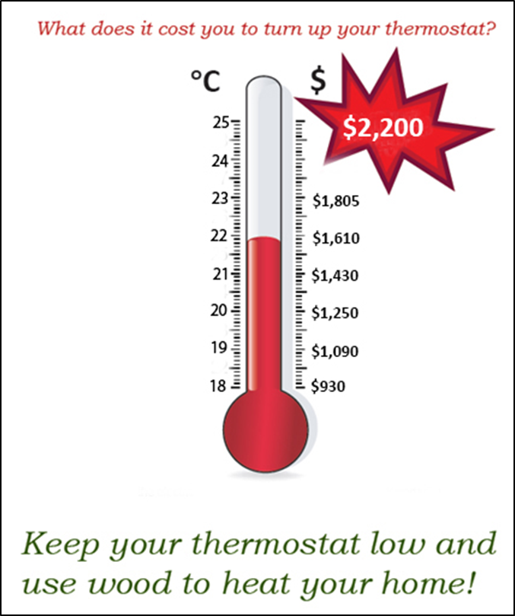
Heating – What is the cost?
For every degree, annual costs can increase by $190!
Notes:
Current values are for Zone 1 blended rate with electrical heating
For Zone 1 blended rate with electrical heating:
Lower Mainland – average of $190 per degree
South Interior – average of $180 per degree
North Interior – average of $215 per degree
Because space heating accounts for so much of our energy usage, how we manage it makes a big difference to our costs.
The more leaks and drafts we have unsealed, the higher we set our thermostats to stay warm against cold air. This costs a lot: for every degree you raise your thermostat, your yearly costs can increase by $190!

Slide 20
Heating Systems –
What can be done!
Building:
Install efficient, appropriate heating systems
Change air filters on routine schedule
Ensure both primary and secondary heating systems are safe and functional
  Wood stove venting is sealed and in good shape
  No wires are exposed on electrical heating systems
Behaviour:
Educate residents to properly use programmable thermostats
Check that digital controls are set correctly, especially in less used rooms and hard to reach areas
Encourage residents to decrease home temperature when no one is home during the day and at night
Encourage use of efficient main heating systems instead of space heaters
Notes:
Discuss list of building fixes and behaviours, and any other suggestions the audience brings up.

Slide 21
Appliances and Plug Loads
Building:
Replace old appliances with new Energy Star® rated ones
Ensure all plug outlets are safe and grounded
Behaviour:
Encourage unplugging of space heaters and other high-consumption appliances when not in use
Set appliances to lowest effective setting
Notes:
Discuss list and any other suggestions the audience brings up.

Slide 22
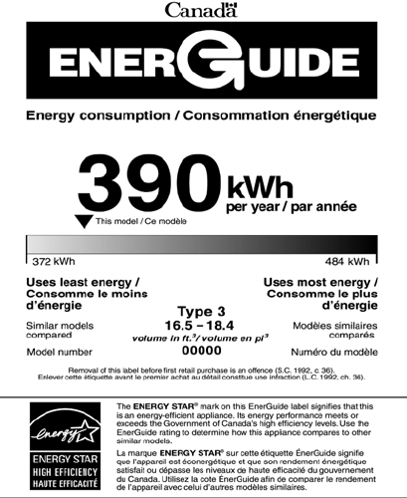
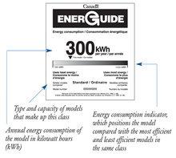
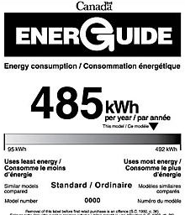
Choose Efficient Appliances
Notes:
You’ve probably seen these labels on your appliances. The numbers on these labels give you a sense of approximately how much energy you are using per year running this appliance. But the usage does rely on typical usage throughout a year so using them more frequently or less efficiently (such as holding a fridge door open for several minutes) will increase how much energy they’re using.
When you’re buying a new appliance, even though one that is less energy efficient might be cheaper, if it uses a lot more energy, you may end up paying a lot more for it in the long run. Look for labels like the top one, that falls on the low end of energy use.

Slide 23
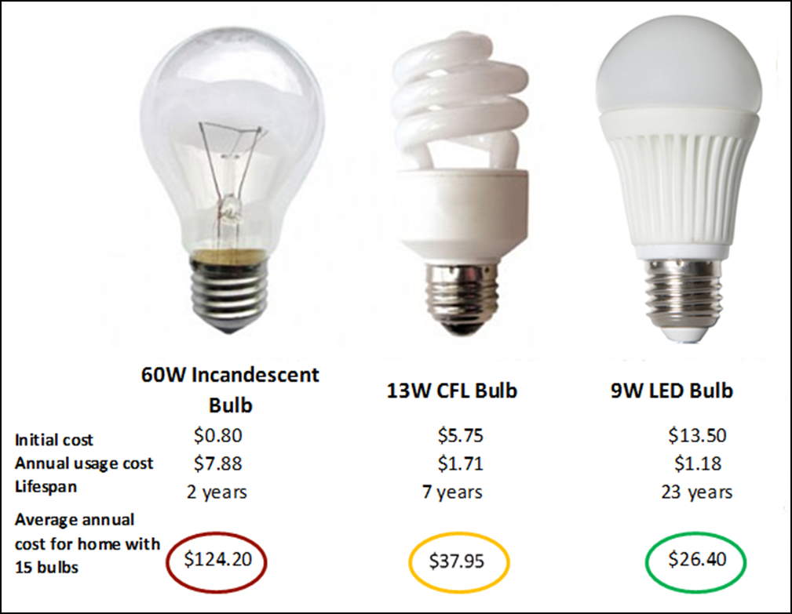
Lightbulb Cost Comparison
Notes:
Explain, using this chart, how even though initial costs of incandescent bulbs may be lower, because they don’t last as long and because their consumption costs are so much higher per bulb, the overall cost of an incandescent bulb is actually higher than that of a CFL, or an LED lightbulb (the best option for cost, appearance, and light quality).

Slide 24
Lighting and Ventilation –
What can be done!
Building:
Replace incandescent bulbs with efficient LED (preferred) or CFL bulbs
Ensure bathroom and kitchen fans are sized appropriately, and maintained in good working order
Behavior:
Encourage use of kitchen and fans throughout the day, especially when showering and cooking to reduce excess humidity
Notes:
Discuss list of actions and behaviours, and any other suggestions the audience brings up.

Slide 25

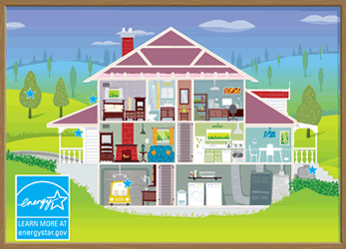

Benefits of Energy Efficient Practices
Cost savings
  Lower utility bills for all residents to keep more money in the community for other programs
  Lower maintenance costs
  Increasing lifespan of current and new housing stock
Home comfort
  Reduced drafts and hot/cold spots
Health impacts
  Improved ventilation and insulation reduces occurrence of mold
  Safer homes, especially for the young and Elders
Lower impact on the land
  Reduced greenhouse gas emissions
  Contribute towards lower provincial energy use and
  potentially eliminate need for new energy generation locations
Notes:
Even though we’ve been talking a lot about cost savings, there are lots of other benefits that are really important that come with energy efficiency practices.
Discuss the list of benefits in an interactive way, focusing particularly on aspects that the community has identified as important to them (if having a lower environment impact is very important, for example).

Slide 26
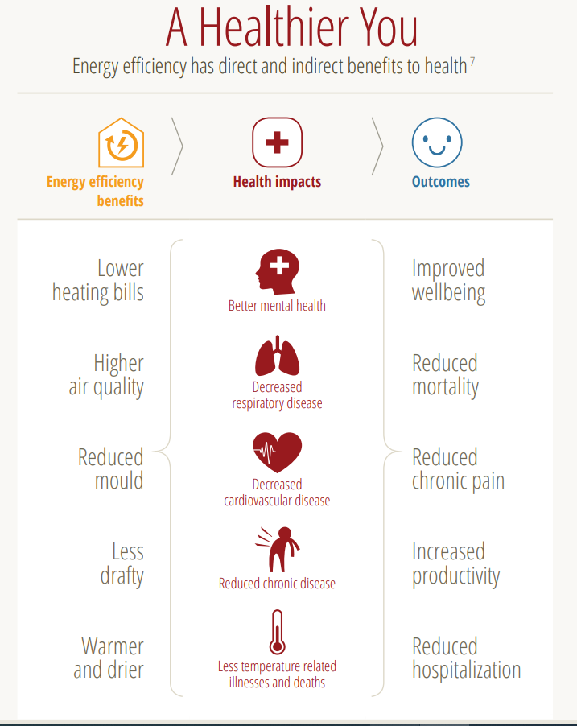
Energy Efficiency & Health

Slide 27
Energy Efficiency Policy Self Assessment Tool
Policy Areas | No EE Policy |  |  |  | Highly Developed EE Policy
Policy development and use | No guidelines around EE | The Band has an unwritten set of guidelines around EE | The Band has an EE policy but the policy has not been formally adopted by the Leadership | The Band has a formal EE policy the policy but no active ongoing commitment from the Leadership | The Band has an EE policy action plan which is regularly reviewed and has active commitment of the Leadership
Organization | No delegation or responsibility for managing energy use by the community | Informal and loose EE requirements with the Band mainly focused on energy supply | There is some delegation of responsibility for EE but line management and authority is unclear | There is a clear line for accountability by the Band administration around the overall consumption of energy and responsibility for the efficient use of energy | The EE policy is fully integrated into Band administration structure with clear accountability for the community’s overall energy consumption
Investment | No investment in improving energy efficiency | Only low or medium cost measures are considered. Other measures are only considered when required by funders | Low or medium cost measures for EE are routinely considered when short payback periods are achievable | Equal appraisal criteria used for energy as for other cost reduction projects | Resources routinely committed to EE in support of Band objectives
Performance Measurement | No measurement or records of energy consumption completed | Check of energy related invoices only | Monthly monitoring by fuel type | Scheduled energy performance measurement for each process, unit or site | Comprehensive energy performance measurement against targets with effective reporting to Leadership and community
Staff Training | Informal EE organization. Main focus on ensuring secure energy supply | Technical staff occasionally attend specialist courses | Ad-hoc training for selected staff, as required | Energy training targeted at major users following training needs analysis | Comprehensive staff training tailored to identify EE opportunities and to develop business cases which can be acted upon
Communications | No communications or promotion of EE issues | Ad-hoc informal contacts used to promote EE | Some use of organization communication mechanisms to promote EE | Regular staff briefings, performance reports and EE promotion | Extensive communication of energy issues and impacts within the Band administration and community
Notes:
This tool was developed to assist communities in assessing where they currently are in terms of energy policy, and to highlight the steps in getting to where they would like to end up. The choice of how developed to make any one area of policy lies with your community, and the series of steps is just a guideline to visualize how you can get there.

Slide 28
Energy Efficiency
Policies and Procedures
Energy efficiency policies can be incorporated into current or new Housing Policy documents, in areas of:
  Administration
  Maintenance
    Procurement processes and quality of materials
  Construction
    Contractor qualifications, lifecycle analysis of materials, Building Code requirements for BC
There are energy and non-energy benefits of having a Housing Policy that incorporates energy efficiency policy:
  Improved maintenance procedures, practices, and materials
  Structured rental policies
  Clear administrative responsibility for overseeing Housing Policy and related activities
Notes:
Some benefits include:
-improved practices and materials, which reduces workload strain and moves maintenance from a more reactive to proactive system
-stronger construction standards for both building and inspection ensures homes are built properly, and able to be maintained properly, which fulfills two of the three key factors in energy efficiency that were discussed
-defined responsibility for overseeing housing and energy related matters

Slide 29
Involving the Community
Energy Champion
Community-based leader who works to facilitate energy project, shares energy knowledge, and acts as energy contact for other residents
Green Team
All-ages community team supporting other members in reducing energy use
Social media or other platform for sharing tips, knowledge, and information
Set community-wide challenge and goals
Notes:
Discuss ways to drive momentum within the community, and start a discussion on how to get this community involved and interested from those in attendance.

Slide 30
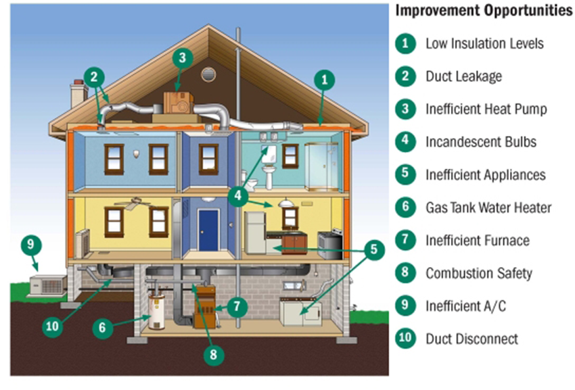
Questions and Discussion
Notes:
Use graphic as an aid in discussion.

