Slide 1
Energy Efficiency in <community>
<Insert community photo or logo>
A joint initiative brought to you by:
Ministry of Energy and Mines
BC Hydro
Developed and delivered by:
Quality Program Services
Notes:
Introduction of presenters.
Welcome the community and elders.
Thank you for the welcome into their space.
Explain why you’re here.

Slide 2
Introduction and Outline
Why energy use should matter to you!
Energy use and home structure
Understanding your utility bills
What impacts energy use
Benefits of being energy efficient, for you and your community
What can you do?
Notes:
Go over the outline of what will be covered in this presentation.

Slide 3
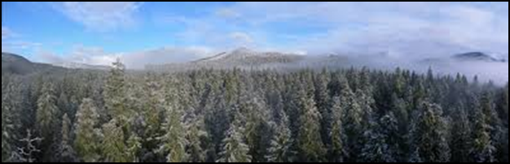
Why it Matters
How energy use impacts community members:
  Utility bills
  Improve home comfort
  Home safety and health
  Protect the land
Energy use is on the rise in BC, and our intent is to decrease energy consumption to take pressure off the system as a whole
Notes:
Incorporating energy efficiency practices and a larger program impacts residents:
-your utility bills (whether paid by homeowners or by the community)
-your home’s comfort (we all want to be warm and comfortable in our homes)
-your health and safety (drafts and mould can make us uncomfortable or sick)
-your land (how power generation and use can impact the environment)

Slide 4
General Energy Information
The energy supply in <insert community> comes from:
Natural gas
Typically found above petroleum resources
Propane
Byproduct of natural gas processing and petroleum refining
Electricity
Hydroelectricity and/or diesel generation in remote communities
Wood
Locally sourced and used
Notes:
Give context about the impacts of the energy use applicable to this community (e.g. electricity and natural gas primarily).

Slide 5
<Insert community> -specific Energy Information
Housing types and age
Ask about typical bills
(Community and individual)
Current programs or initiatives regarding housing and organizational structure
Short and long term outlook for housing: new construction and upgrades
Notes:
Explain (based on previous investigation/data gathering) or ask the community about their current energy efficiency situation, including:
Most common types and ages of housing in the community
How much the community is paying for electricity (all types) as a whole or as individual homeowners
Existing programs and initiatives shaping community housing and home energy usage/ energy efficiency
Challenges being faced by different groups in the community (budgetary, maintenance, living situation, etc.)

Slide 6
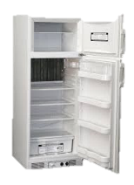

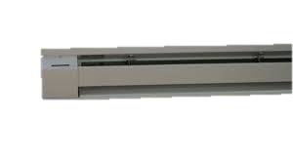


Where are your energy dollars going?
A Breakdown of Average Canadian Home Energy Use
When Total Energy Bill is $2,000 a year
Notes:
The average Canadian spends about $2000 per year on electricity.
*this data is from a few years ago, so the number may be a bit higher now.
When we look at where this energy is being used, we can see that 60 percent of it ($1,200) is going to Space Heating.
Another 20 percent is going to Water Heating.
Appliances (refrigerators, televisions), lighting and cooling make up the rest, but they are a much smaller portion.

Slide 7
First Nation Energy Use and Cost can be Double*
When Total Energy Bill is $4,000 a year
*No statistical data available – based on anecdotal experience
Notes:
Anecdotal evidence suggests that energy costs for First Nations communities can be double, or more, the costs for the average Canadian household.
This means many First Nations households can easily be spending $4,000/year on energy (primarily a combination of electricity and gas costs).
In these cases, that means that 80%, or $3,120 of those energy dollars, are going to space and water heating alone!
So if you want to lower your bills, where should you focus your efforts?
Changing lightbulbs isn’t a bad idea, but prioritizing improvement to heating and keeping heat in (i.e., draftproofing) is where you can make the biggest impact.

Slide 8
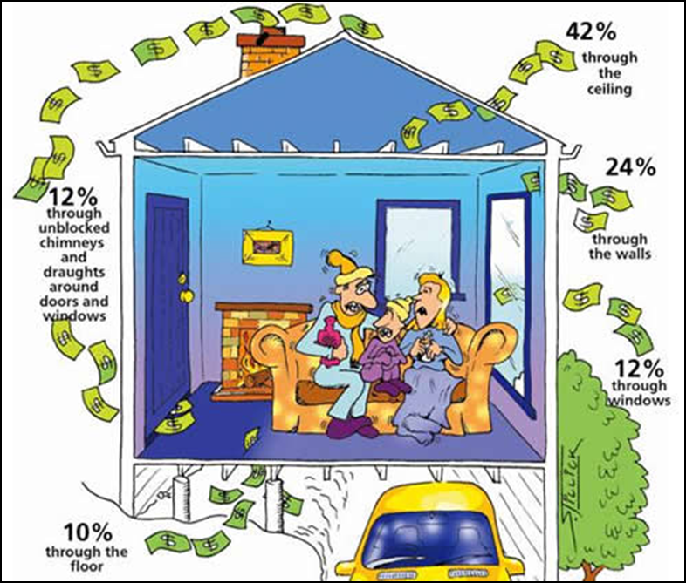
Where Dollars Escape
Notes:
If space heating is our biggest energy cost, then whenever we lose heat, we’re actually losing dollars.
Thinking about it like this, we can imagine that anywhere things aren’t well sealed, insulated, or blocked, we’re allowing energy dollars to escape.
This can happen through uninsulated floors, walls, ceilings, through poorly sealed or cracked windows and doors, or unblocked chimneys or other venting systems.

Slide 9
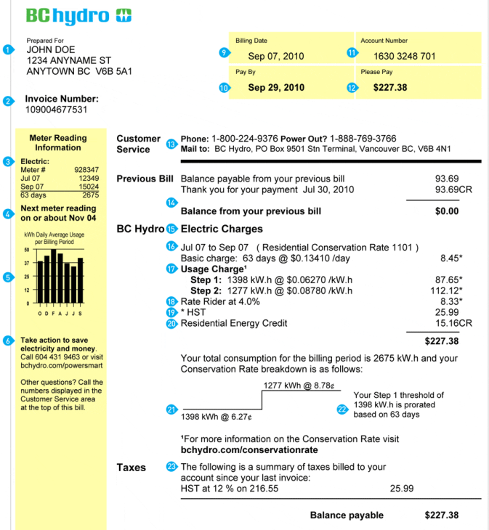
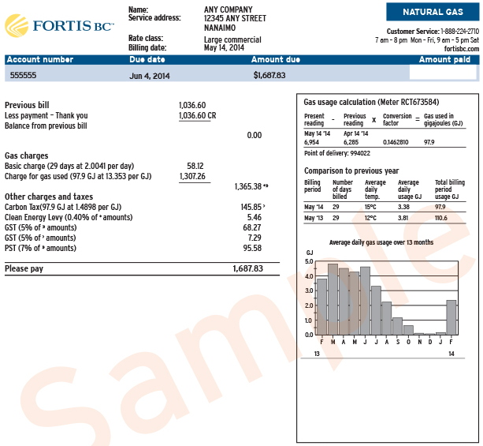
Understanding Your Energy Bill
Notes:
There is a lot of information on your energy bills, but if you’re only going to take note of a couple different parts, take note of these ones:
Hydro:
Your Hydro rates are stepped. That means that usage up to a certain amount is charged at $0.XX [use rates for this community], and anything you use beyond that number of kWhs is charged at a higher rate. If possible, it’s best to try to stay below the threshold where you jump up to the higher rate. You might not notice this in your bills (if you have equal payment billing, for example), but you will be paying for it in the end.
Fortis:
On the side of your Hydro bill and also on your Fortis bill, there is a little bar chart that shows your usage over the year. Take a look at this and see where there are fluctuations. If you live in a place where you don’t use space heating in summer months, the levels you’re using in summer months are mostly how much you’re using to heat water and power appliances.

Slide 10

Notes:
[Only for communities with Smart Meters]
BC Hydro has a great program called My Hydro.
Ask if anyone present is signed up.

Slide 11
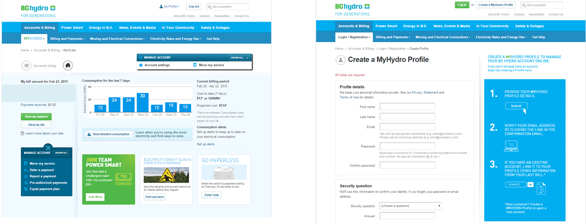
Using My Hydro
Notes:
With My Hydro, you can log on and see your energy usage in real time. This is really helpful if you’re not sure where you’re using electricity.
If your home is empty all day and you have spikes in your usage during that time, maybe you have baseboard heaters on (and set too high). This can help you figure out where you’re using your energy.
All you have to do is create a profile (it’s free).
It’s also a great place to find tips and to learn about rebates and other programs that might be available to you.

Slide 12
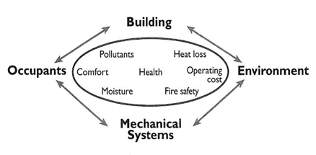
Factors Affecting Energy Use
Construction
  Building code standards
  Installation and inspection procedures
Maintenance
  Materials procurement
  Procedures
Energy awareness
  Knowledge
  Behaviours
Notes:
There are 3 main contributors to energy consumption:
Construction
-to what level of building code standard we decide to build to which essentially describes how well our homes are designed, built and what materials are used
-level of professionalism in installation and inspection procedures
Maintenance
-how we keep our homes in good shape (or not)
-what materials and methods we’re using for maintenance
and Behaviour
-what we know about how to reduce our consumption
-if we actually do it

Slide 13
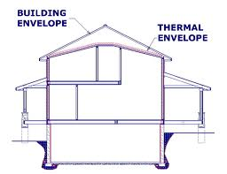
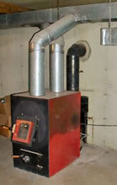
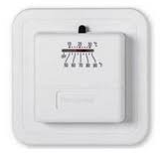
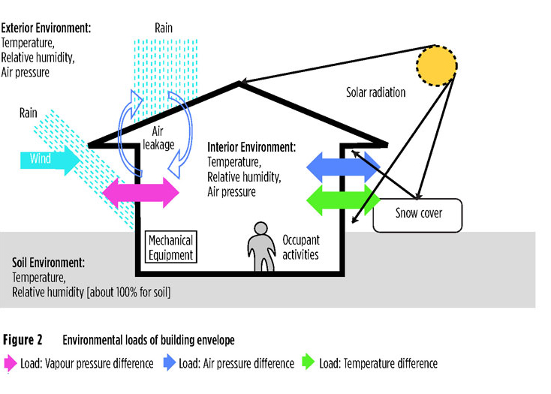
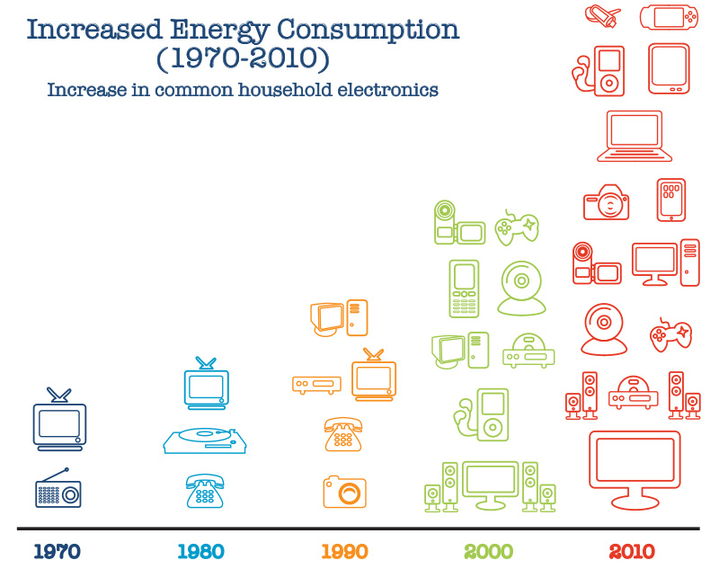
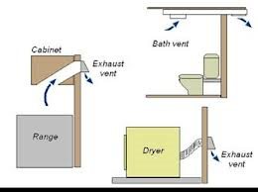
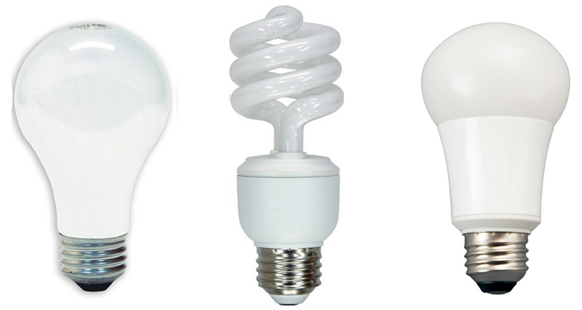
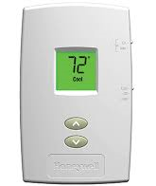
Home Structure and Components
Building envelope
  Moisture and ventilation
Heating systems
  Controls
Lighting
Appliances and
plug loads
Notes:
Our Home Structure and Components help determine out energy usage:
The Building Envelope is our walls, floors and roofs – everything that keeps weather out and keeps warmth in. We also want to consider the movement of moisture in our homes, particularly when we start to improve how airtight they are. When homes are sealed really well, a good ventilation system needs to be in place to move air, and remove excess moisture from showering, cooking, etc.
How we use heating system controls (thermostats) also makes a big impact: using old analog thermostats or dials on baseboard heaters can be very inefficient, and installing programmable thermostats that regulate temperature better can have a big impact on bills.
The light bulbs we choose make a difference too, and can really add up depending on how many lights we have in our home. LED bulbs are the most efficient, compared to old incandescent ones, and provide a lot nicer light than CFL bulbs.
Finally, since the 1970s, the number of appliances we have in our homes has changed a lot. It isn’t uncommon for one household to have multiple TVs, computers and all sorts of gadgets plugged in and running which really increases the load on our homes.

Slide 14
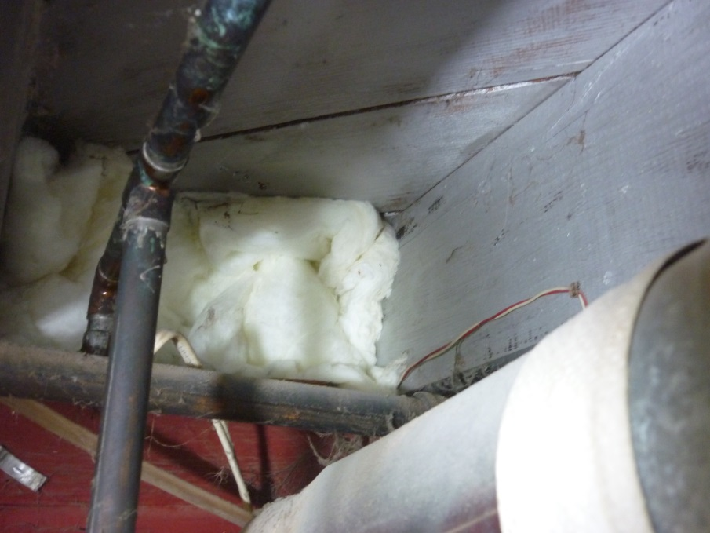
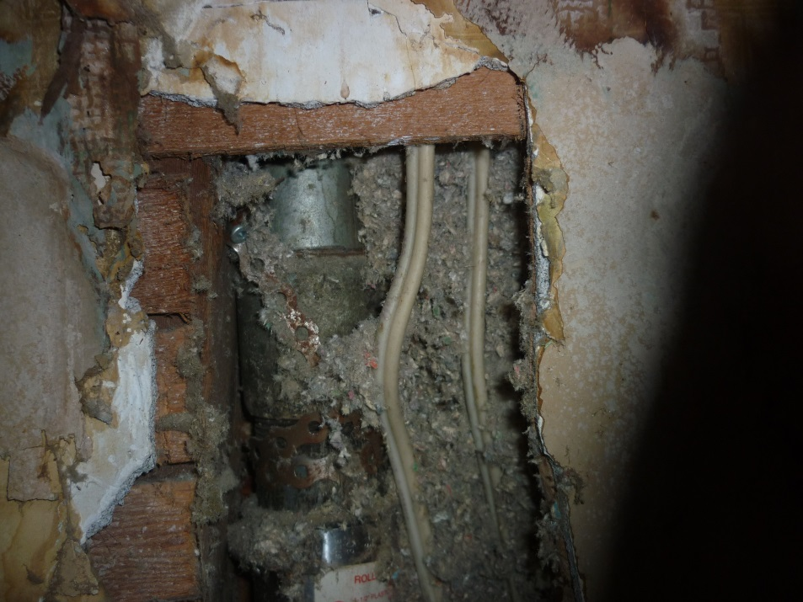
Envelope Air Sealing –
What does it cost?
Cost:
___/year
Cost:
___/year
Notes:
Assumptions: Electrical cost Zone 1 blended rate as of March 1, 2015.
Lower Mainland – Box joists: $28.00; hole in wall (110cm²): $36.00
South Interior – Box joists: $50.00; hole in wall (110cm²): $55.00
North Interior – Box joists: $74.00; hole in wall (110cm²): $105.00

Slide 15
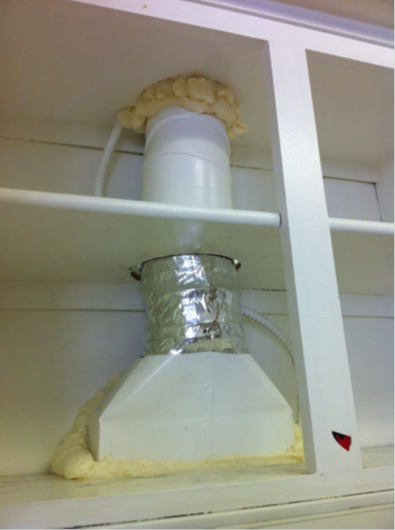
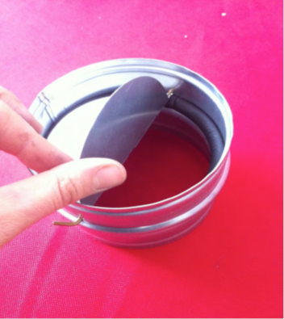
Fans, Vents, and Ducts
Cost:
___/year
Notes:
Assumptions: Electrical cost Zone 1 blended rate as of March 1, 2015
Lower Mainland – $18.00
South Interior – $22.00
North Interior – $42.00

Slide 16
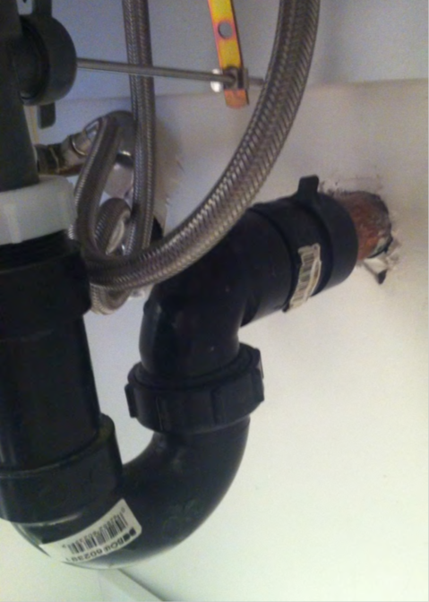
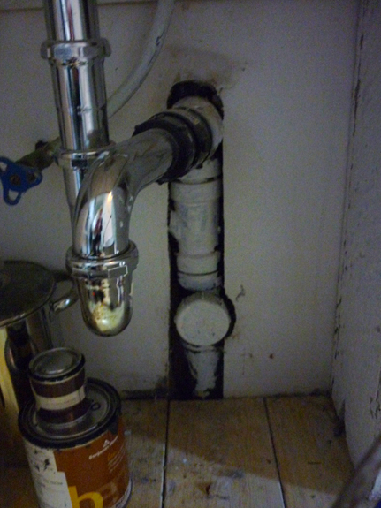
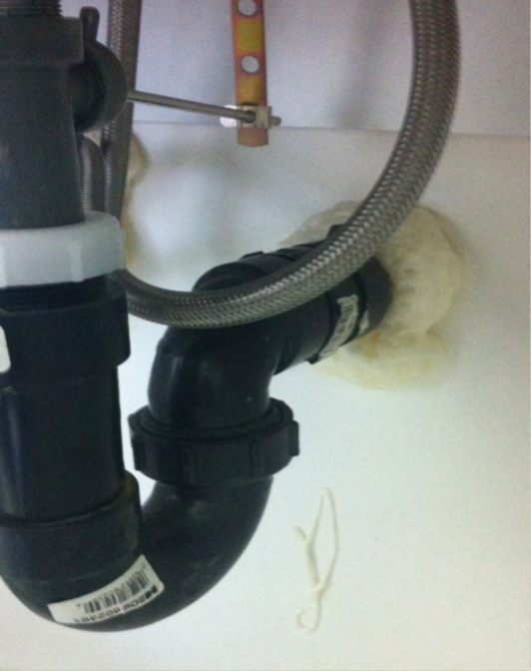
Plumbing and Penetrations
Cost:
___/year for 3 pipes
Notes:
Assumptions: Electrical cost Zone 1 blended rate as of March 1, 2015. Homes have 3 plumbing penetrations.
Lower Mainland – $54.00
South Interior – $66.00
North Interior – $125.00

Slide 17

Exterior Doors
Cost:
__/door/year
Notes:
Assumptions: Electrical cost Zone 1 blended rate as of March 1, 2015. Value per door.
Lower Mainland – $5.00
South Interior – $7.00
North Interior – $13.00

Slide 18
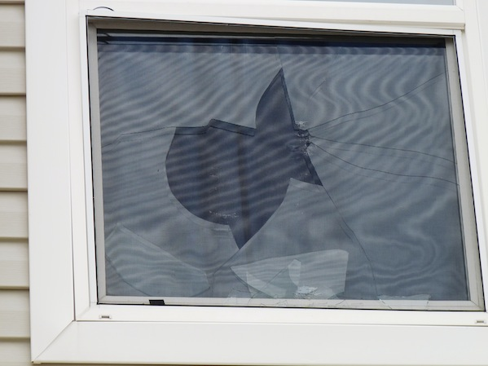
Windows
Cost:
___/window/
year
Cost:
__/window/year
Notes:
Assumptions: Electrical cost Zone 1 blended rate as of March 1, 2015. Value per window.
Broken window/single pane:
Lower Mainland – $23.00
South Interior – $42.00
North Interior – $63.00
Window gap:
Lower Mainland – $4.00
South Interior – $5.00
North Interior – $10.00

Slide 19
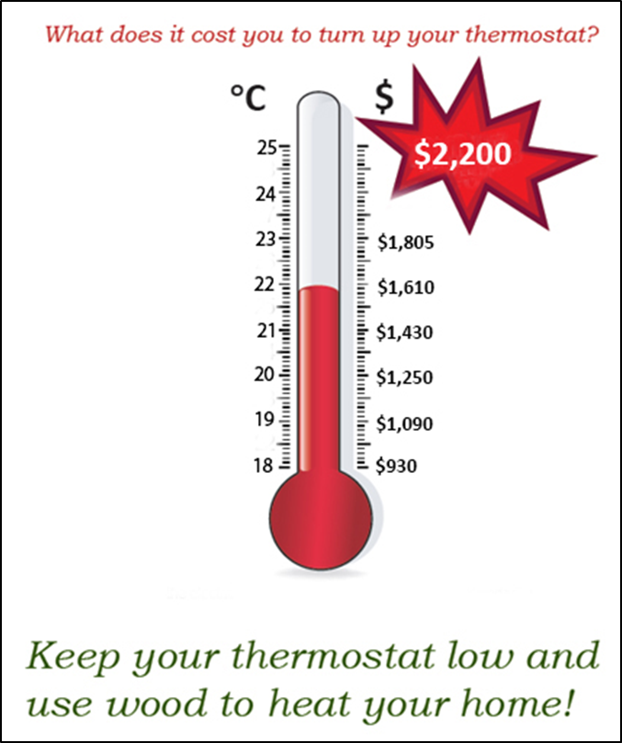
Heating – What is the cost?
For every degree, annual costs can increase by $190!
Notes:
Current values are for Zone 1 blended rate with electrical heating
For Zone 1 blended rate with electrical heating:
Lower Mainland – average of $190 per degree
South Interior – average of $180 per degree
North Interior – average of $215 per degree
Because space heating accounts for so much of our energy usage, how we manage it makes a big difference to our costs.
The more leaks and drafts we have unsealed, the higher we set our thermostats to stay warm against cold air. This costs a lot: for every degree you raise your thermostat, your yearly costs can increase by $190!

Slide 20
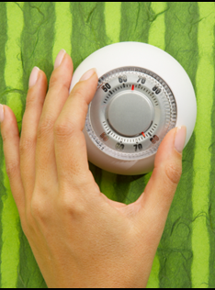
What can Residents Do?
Energy Efficient Actions
Air Sealing and Heating
Reduce drafts
  Seal obvious gaps and air leaks, especially around doors, windows, plumbing, and electrical outlets
  Have broken or cracked windows and doors replaced
  Use a door sock at the bottom of doors
Open curtains to let the sun in and heat rooms during the day then close them at night to keep heat in
Avoid using portable electric heaters
Turn down your thermostat at night and during the day if no one is home
Change the furnace filter regularly
Notes:
Ask audience members what actions they can think of to improve air sealing and heating to save energy.
After some brainstorming, go through the list.

Slide 21
What can Residents Do?
Energy Efficient Actions
Hot Water
You might not pay for water but you do pay to heat water!
  Check that all taps have aerator ‘screens’ on them to use water efficiently
  Insulate hot water heater pipes
Take shorter 5 minute showers!
Wash clothes in cold water and use the correct setting for size of load
Make sure hot water heater is set to the correct temperature (55°F)
Notes:
Discuss list of actions and behaviours, and any other suggestions the audience brings up.

Slide 22
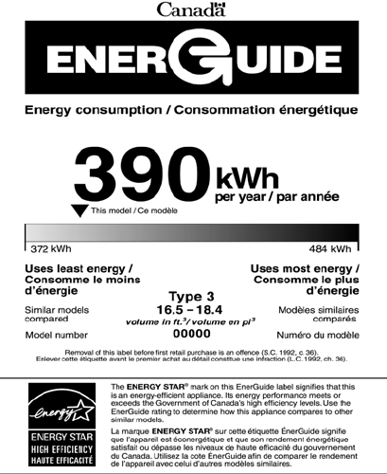
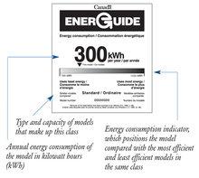
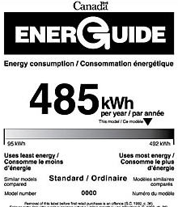
Choose Efficient Appliances
Notes:
You’ve probably seen these labels on your appliances. The numbers on these labels give you a sense of approximately how much energy you are using per year running this appliance. But the usage does rely on typical usage throughout a year so using them more frequently or less efficiently (such as holding a fridge door open for several minutes) will increase how much energy they’re using.
When you’re buying a new appliance, even though one that is less energy efficient might be cheaper, if it uses a lot more energy, you may end up paying a lot more for it in the long run. Look for labels like the top one, that falls on the low end of energy use.

Slide 23
What can Residents Do?
Energy Efficient Actions
Appliances and Plugs
Clean dryer lint screens to help clothes dry faster!
Unplug appliances with LED lights or those that ‘stay on’ when you’re not using them
Keep the fridge closed until you decide what to eat
Put all food into one fridge/freezer if you have two half-empty ones and unplug the extra one
Notes:
Discuss list of actions and behaviours, and any other suggestions the audience brings up.

Slide 24
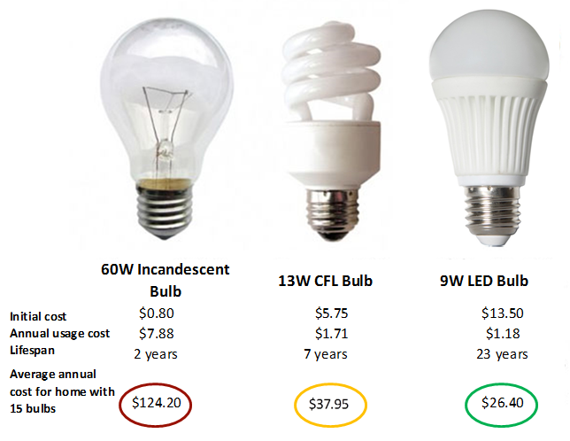
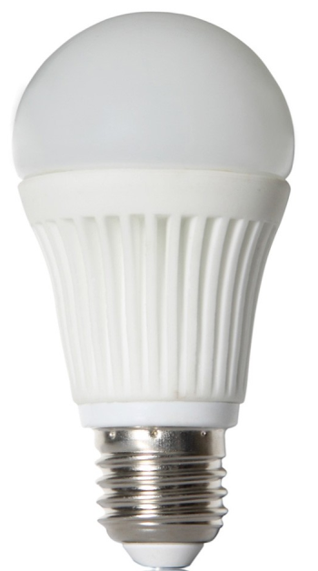
Lightbulb Cost Comparison
Notes:
Explain, using this chart, how even though initial costs of incandescent bulbs may be lower, because they don’t last as long and because their consumption costs are so much higher per bulb, the overall cost of an incandescent bulb is actually higher than that of a CFL, or an LED lightbulb (the best option for cost, appearance, and light quality).

Slide 25
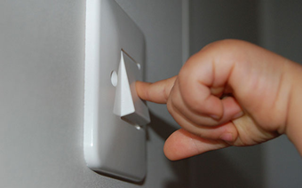
What can Residents Do?
Energy Efficient Actions
Lights and Ventilation
Turn off the lights in
unused rooms
Turn off outdoor lights during the day
Use bathroom and kitchen fans to keep air circulating
  Tip!! Make sure to keep the fans clean – clean them when you check the batteries in smoke alarms every 6 months!
Notes:
Discuss list of actions and behaviours, and any other suggestions the audience brings up.

Slide 26

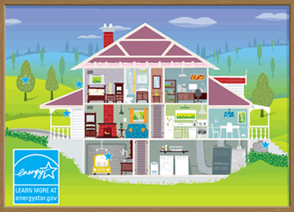

Benefits of Energy Efficient Practices
Cost savings
  Lower utility bills for all residents to keep more money in the community for other programs
  Lower maintenance costs
  Increasing lifespan of current and new housing stock
Home comfort
  Reduced drafts and hot/cold spots
Health impacts
  Improved ventilation and insulation reduces occurrence of mold
  Safer homes, especially for the young and Elders
Lower impact on the land
  Reduced greenhouse gas emissions
  Contribute towards lower provincial energy use and
  potentially eliminate need for new energy generation locations
Notes:
Even though we’ve been talking a lot about cost savings, there are lots of other benefits that are really important that come with energy efficiency practices.
Discuss the list of benefits in an interactive way, focusing particularly on aspects that the community has identified as important to them (if having a lower environment impact is very important, for example).

Slide 27
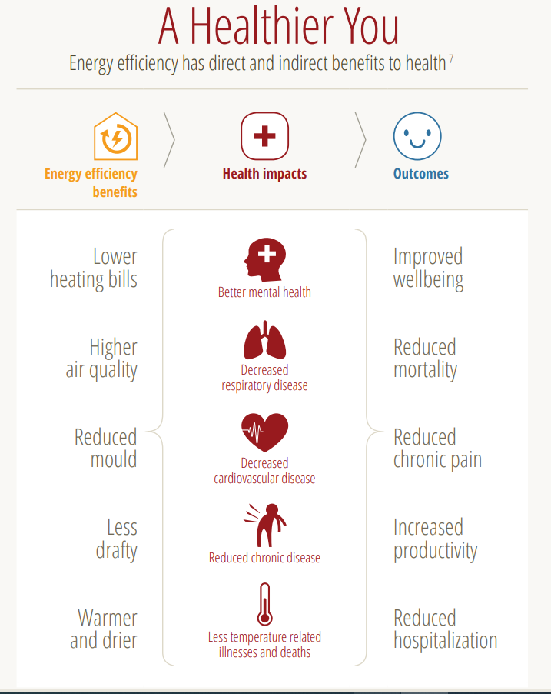
Energy Efficiency & Health

Slide 28
Involving the Community
Energy Champion
Community-based leader who works to facilitate energy project, shares energy knowledge, and acts as energy contact for other residents
Green Team
All-ages community team supporting other members in reducing energy use
Social media or other platform for sharing tips, knowledge, and information
Set community-wide challenge and goals
Notes:
Discuss ways to drive momentum within the community, and start a discussion on how to get this community involved and interested from those in attendance.

Slide 29
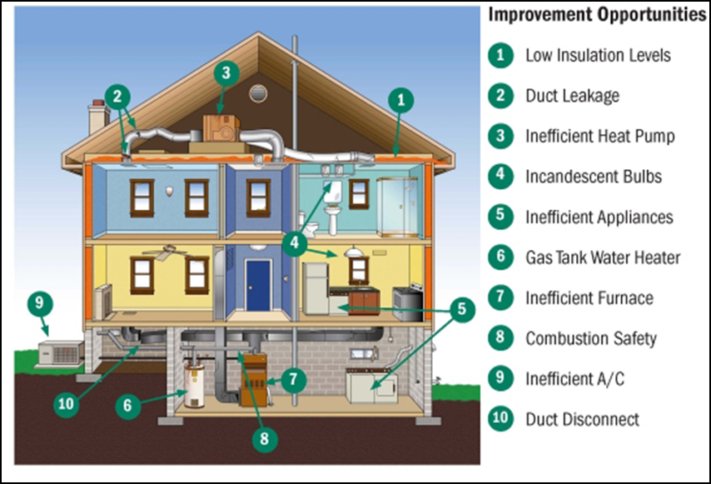
Questions and Discussion
Notes:
Use graphic as an aid in discussion.

